Slide 1
Flat and Nested Distributed Transactions

Slide 2
1. Flat Transactions
Structure: Sequential execution across multiple servers.

Slide 3
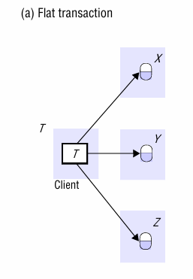
1. Flat Transaction

Slide 4
1. Flat Transactions
Example:
  Transaction T (client) performs operations on Servers X, Y, Z in sequence .
  Each operation (e.g., a.withdraw(100), b.deposit(100)) must complete before the next begins.
  Limitation: Limited concurrency due to sequential execution.

Slide 5
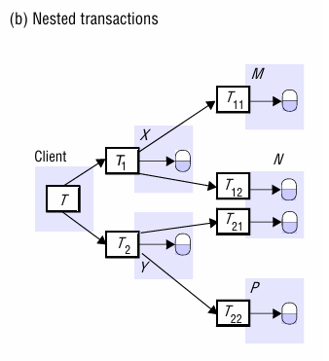
2. Nested Transactions
Structure: Hierarchical execution with subtransactions.

Slide 6
2. Nested Transactions
Example:
  Top-level transaction T spawns subtransactions T1 and T2 (Figure 17.1(b)).
  T1 and T2 run concurrently and can further split into subtransactions (e.g., T11, T12 under T1).
  Advantage: Parallelism improves performance (e.g., multiple transfers processed simultaneously).

Slide 7
3. Flat vs Nested Transactions
Aspect | Flat Transactions | Nested Transactions
Concurrency | Sequential Operations | Sub transactions at the same level run in parallel
Failure Handling | All-or-nothing: entire transaction aborts on failure | Partial commits/aborts possible(e.g., T1 aborts, T2 commits)
Complexity | Simple coordination | Complex hierarchy with parent-child dependencies.

Slide 8
4. Coordinator and Participants
Coordinator: Manages transaction lifecycle (commit/abort).
  Created via openTransaction().
  Tracks participants via join() method (Figure 17.3).
Participants: Servers involved in the transaction (e.g., BranchX, BranchY).
  Example: Withdrawing from Account A notifies Participant A, which joins the transaction.

Slide 9
5. Nested Transaction Rules
Provisional Commit: Subtransactions can commit independently but depend on parents.
Abort Propagation: If a parent aborts, all its subtransactions abort (Figure 17.8).
Final Decision: Top-level transaction determines the outcome for all subtransactions.

Slide 10
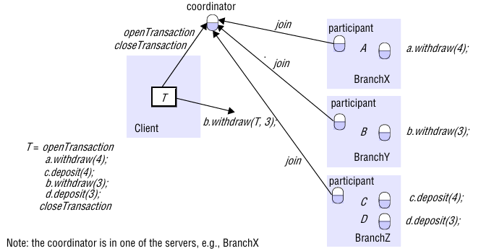

Slide 11
6. Usecase
Banking Example
  Transfer $4 from Account A (BranchX) to C (BranchZ).
  Transfer $3 from Account B (BranchY) to D (BranchZ).
  Participants (BranchX, Y, Z) join via coordinator to ensure atomicity.

Slide 12
7. Atomic Commit Protocol
Ensures all participants commit or abort (e.g., Two-Phase Commit).
Critical for consistency in distributed systems.

